Slide 1
Fiber To The Permises
Where Designs meets
Innovation

Slide 2
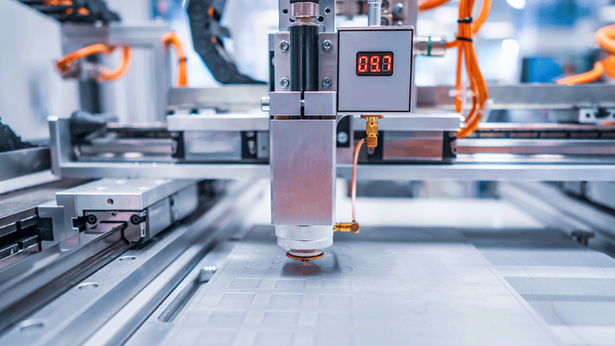
GLASS WORLD
2008
Journey
Begins
GLASS WORLD INNOVATION (PVT) Ltd.
2016
UPVC

Slide 3
To Explore more prospects beyond our field of expertise. Demonstrate the vast potential of our Group by reaching out to other markets of the world. Create an exemplary value chain of our products and services for our future clients across the world.
Vision

Slide 4
Mission
To become a supplier of choice for our clients by offering them unmatched customized products and services, and wish to develop a long-term relationship with them.

Slide 5
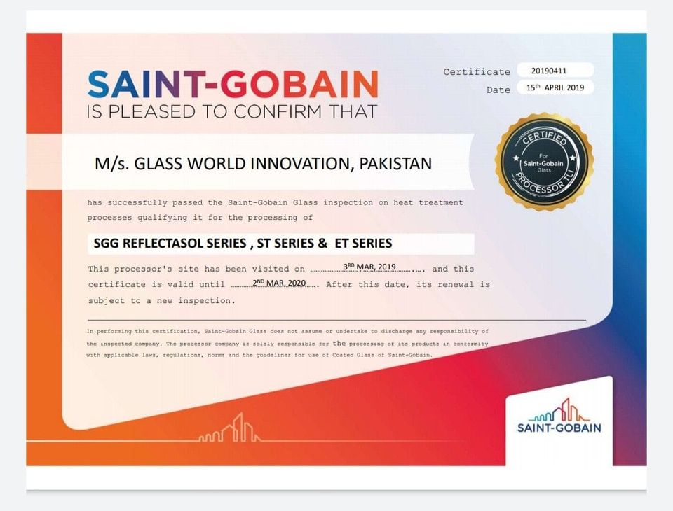
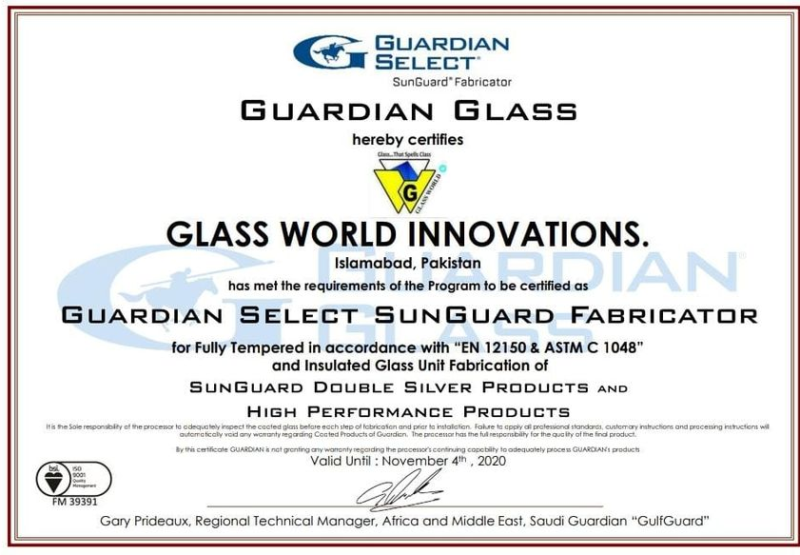
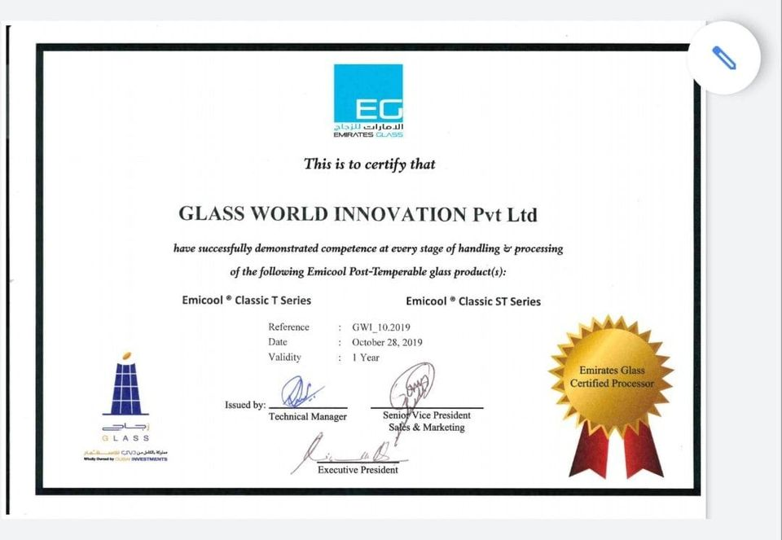
Products
&
Certifications

Slide 6
Business
Is Not
What
Geographical
Expansion
Demographical
Audience
We Invest
CRM
Business
Is
What
We Harvest
Projects
Prices

Slide 7
Geographical Expansion
Twin Cities
Gawadar
GB
Attock
Lahore
KPK
Karachi
Peshawar
Shaikhupura

Slide 8
Demographical Audience
High-rise Plazas
Hospitals
Schools
Universities
Farm Houses
10

Slide 9
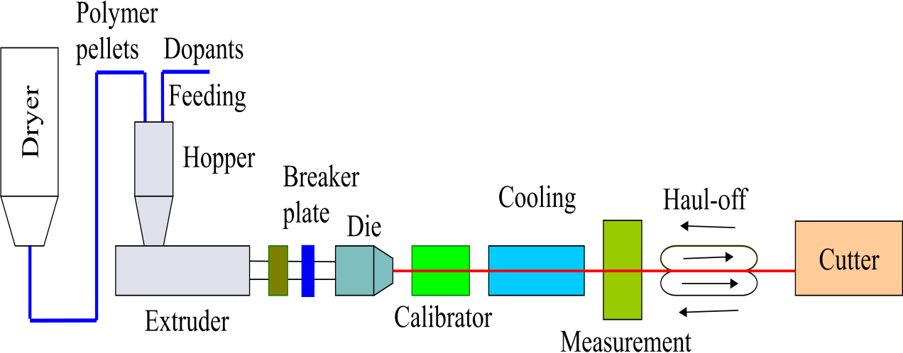
PROCESS
COMPOSITION
Component | PHR Range
PVC RESIN | 70--75
CACO3 | 5--10
Stabilizer ,bailichang, (Malaysia) | 3--4
impact modifier , fm40 kaneka, (japan) | 5--7
tio2, kronos (french) | 5--6
Processing Aid-pa 20 ,kaneka (Japan) | 2--3
UV tex | 0.020--0025

Slide 10
PROJECTS

Slide 11
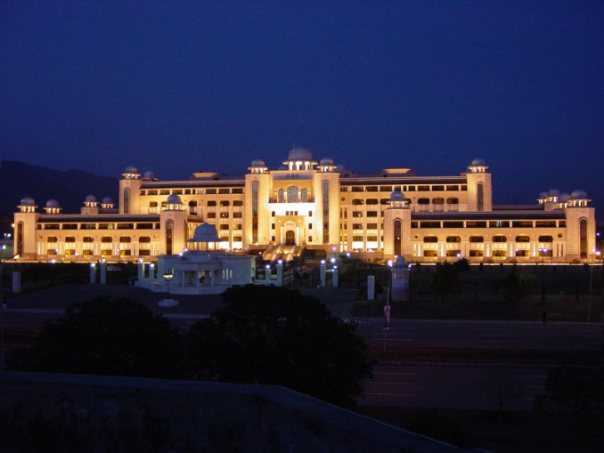
PROJECTS
PC Multan (2019-20)
PAK Secretariat(2019-20)
Dolmen Mall(2019-20)
NUST University(2019-20)

Slide 12
THANK YOU FOR YOUR TIME & ATTENTION
Glass World Innovation (Pvt) Ltd.
Ph. No. 03171170236
contact@glassworldinnovation.com
www.glassworldinnovation.com

